Slide 1

Track module 2
Learning rate schedulers
Running experiments
Visual Transformers
Neural architecture search
Ekaterina Golubeva
27.04.23

Slide 2
Learning rate schedulers
ReduceLROnPlateau | Reduce learning rate when a metric has stopped improving. Models often benefit from reducing the learning rate by a factor of 2-10 once learning stagnates. This scheduler reads a metrics quantity and if no improvement is seen for a ‘patience’ number of epochs, the learning rate is reduced. | scheduler = optim.lr_scheduler.ReduceLROnPlateau(optimizer, factor = 0.1, patience = 5, verbose = True)
StepLR | Decays the learning rate of each parameter group by gamma every step_size epochs. Notice that such decay can happen simultaneously with other changes to the learning rate from outside this scheduler. When last_epoch=-1, sets initial lr as lr. | scheduler = torch.optim.lr_scheduler.StepLR(optimizer, step_size, gamma=0.1, last_epoch=- 1, verbose=False)
MULTISTEPLR | Decays the learning rate of each parameter group by gamma once the number of epoch reaches one of the milestones ( list of epoch indices). Notice that such decay can happen simultaneously with other changes to the learning rate from outside this scheduler. When last_epoch=-1, sets initial lr as lr. | torch.optim.lr_scheduler.MultiStepLR(optimizer, milestones, gamma=0.1, last_epoch=- 1, verbose=False)

Slide 3
Learning rate schedulers
CONSTANTLR | Decays the learning rate of each parameter group by a small constant factor until the number of epoch reaches a pre-defined milestone: total_iters. Notice that such decay can happen simultaneously with other changes to the learning rate from outside this scheduler. When last_epoch=-1, sets initial lr as lr. | torch.optim.lr_scheduler.ConstantLR(optimizer, factor=0.3333333333333333, total_iters=5, last_epoch=- 1, verbose=False)
LINEARLR | Decays the learning rate of each parameter group by linearly changing small multiplicative factor until the number of epoch reaches a pre-defined milestone: total_iters. Notice that such decay can happen simultaneously with other changes to the learning rate from outside this scheduler. When last_epoch=-1, sets initial lr as lr. | torch.optim.lr_scheduler.LinearLR(optimizer, start_factor=0.3333333333333333, end_factor=1.0, total_iters=5, last_epoch=- 1, verbose=False)
EXPONENTIALLR | Decays the learning rate of each parameter group by gamma every epoch. When last_epoch=-1, sets initial lr as lr. | torch.optim.lr_scheduler.ExponentialLR(optimizer, gamma, last_epoch=- 1, verbose=False)

Slide 4
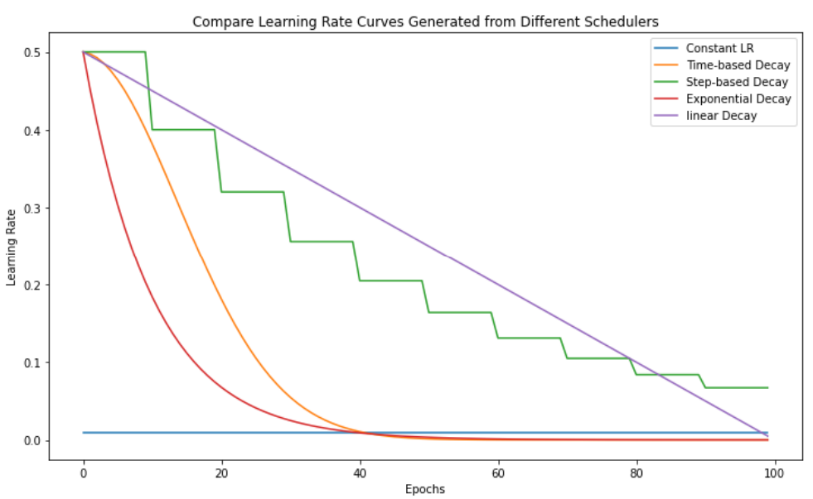
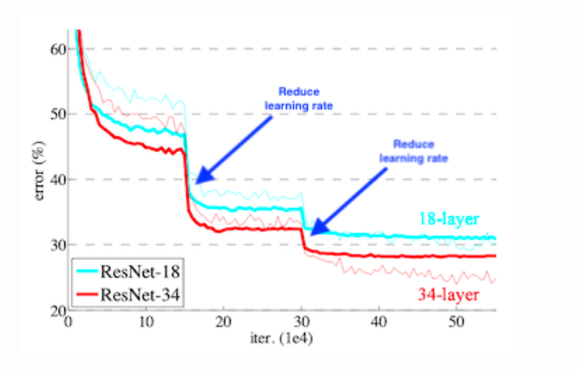
LR Schedulers comparison

Slide 5
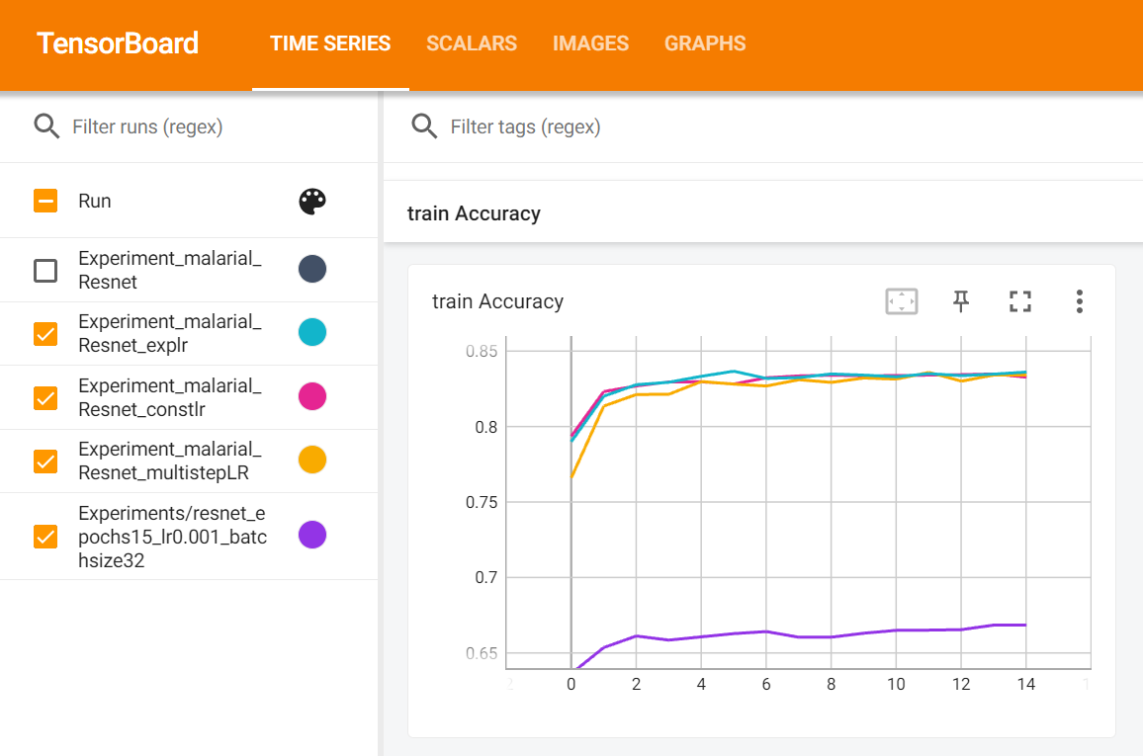
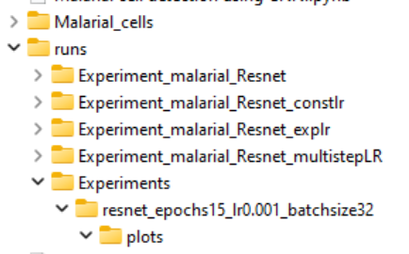
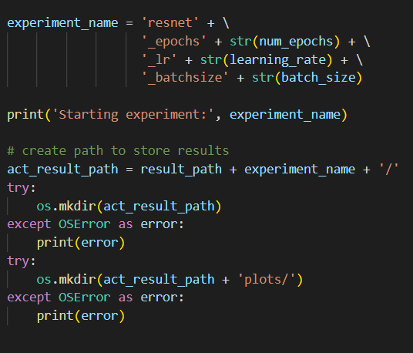
Running experiments

Slide 6

Comparing ResNet, AlexNet and VGG performance on the Malarial cell dataset

Slide 7
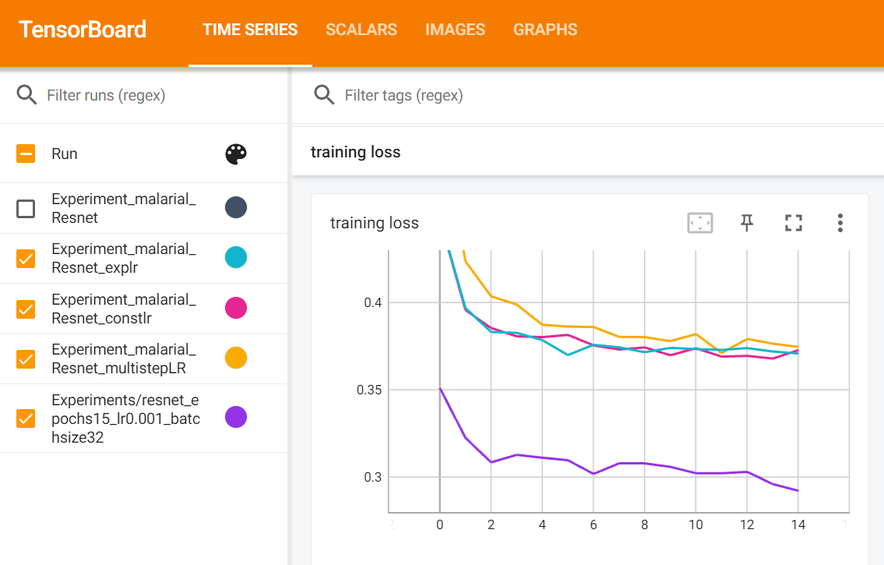
Challenges and solutions
Validation set too small => changed training set splitting
Tensorboard not accessible => learnt how to choose the port
Different lr schedulers need different parameters => decide on milestones, metrics

Slide 8
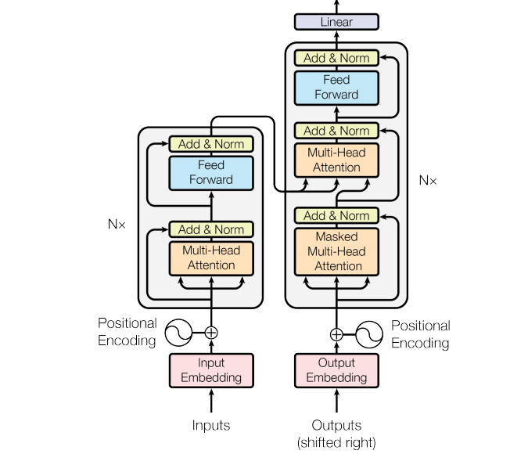
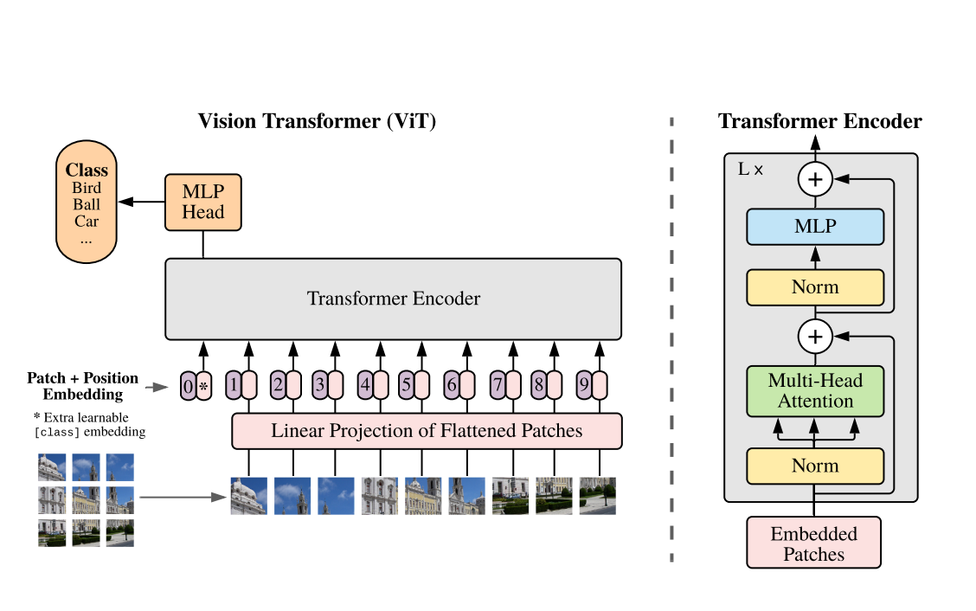
Transformers and Visual transformers

Slide 9
Transformers
Initially developed for Large Language Models (NLP)
Advantages compared to CNN : learns high-level features, relationships
Advantage compared to RNN : can translate sequences in parallel, not sequentially
Is composed by input embedding, positional encoder, attention vector, encoder and decoder blocks and outputs probabilities
Then applied to Medical Images Analysis : we see sentences of words as sequences of image patches

Slide 10
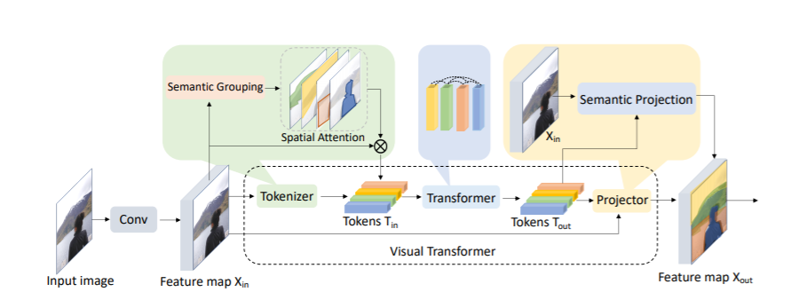
Combining CNN and ViT
We can first convolute patches and then feed the series of low-level features of these pathes to the transformer

Slide 11

Neural Architecture search
Neural Architecture Search (NAS) automates the process of architecture design of neural networks. NAS approaches optimize the topology of the networks, incl. how to connect nodes and which operators to choose.
User-defined optimization metrics can thereby include accuracy, model size or inference time to arrive at an optimal architecture for specific applications. Due to the extremely large search space, traditional evolution or reinforcement learning-based AutoML algorithms tend to be computationally expensive.
Hence recent research on the topic has focused on exploring more efficient ways for NAS.

Slide 12

Next steps
Implement NAS on Malarial cell problem
Debugging
Change train function like Stefan
Fix validation accuracy
Fix plots
Defining MT topic :
Apply pretrained ViT on blood cell classification and compare to simpler approaches

